Slide 1

Billing system
ORIENTAL UNIVERSITY, INDORE
Presented by
Deepak kumar shah
OUI119BCS009
Subject for the Partial fulfilment
Of
B.Tech
In
CSE
Guided by
Dr. Dinesh Jain Sir

Slide 2
abstract
This project is based on billing system. It helps the user(hotel and restaurant) for the billing purpose.
It help those users who are not capable to buy the billing machine as it is costly .

Slide 3
Introduction
This application will allows you to generate customers bill according to there needs.

Slide 4
OBJECTIVE
This system is mainly aimed for the small businesses who are not more financialy abled.
They can use this without any requirement of any other person.

Slide 5
Methodology
The following steps are to be followed in order to implement the proposed system successfully :
Enter the customer details
Enter the choices of customer
Generate the bill

Slide 6
Tools And Technologies
Python 3.10.6
Numpy
Tkinter

Slide 7
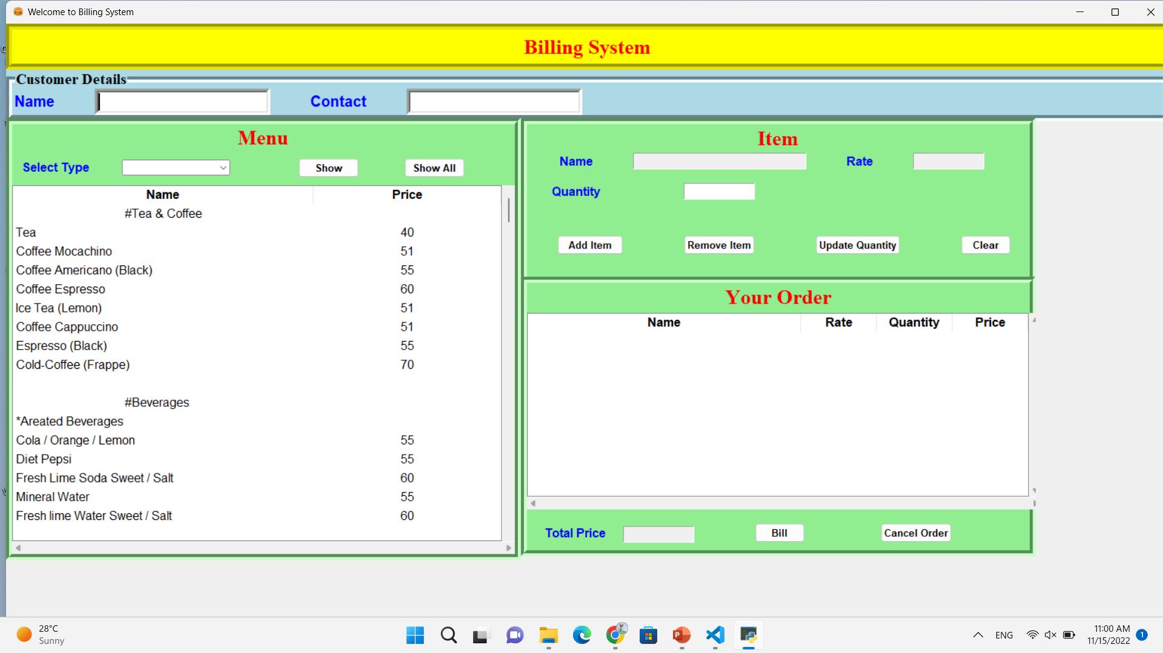
RESULT

Slide 8
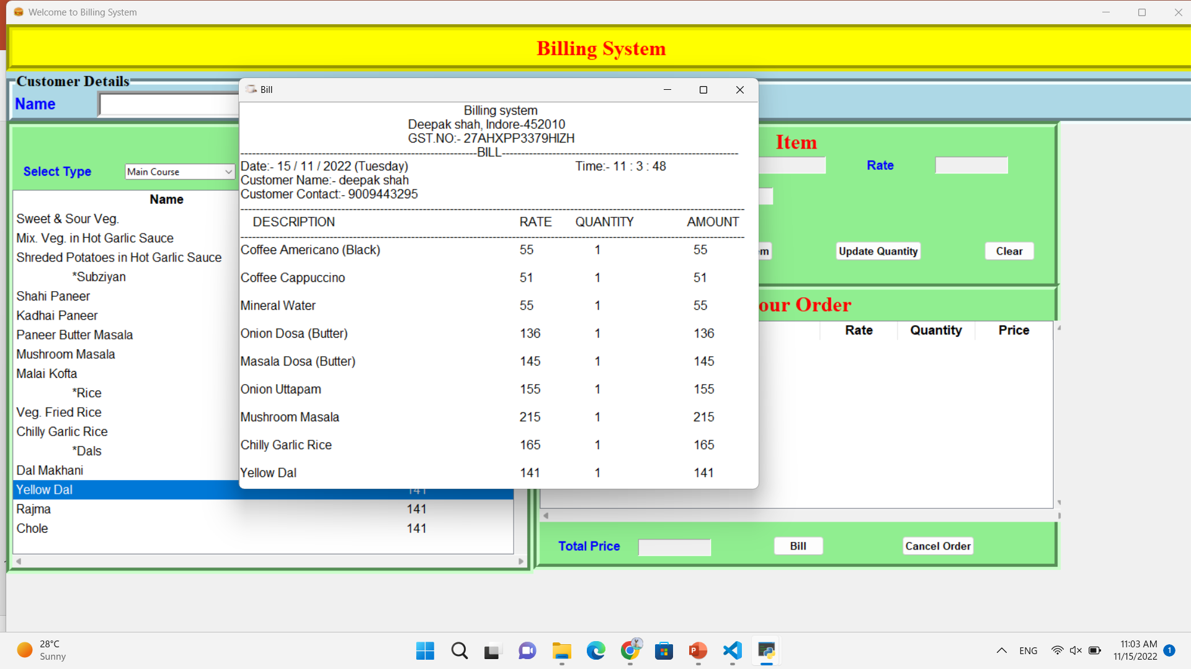

Slide 9
CONCLUSION
Save the money of small hotel or Restraunt.
Also customer Generate or order there order by self.

Slide 10
Future Scope
The future work could be enhanced the system to facilitate issuing of a bill

Slide 11
Thank You…

